Slide 1
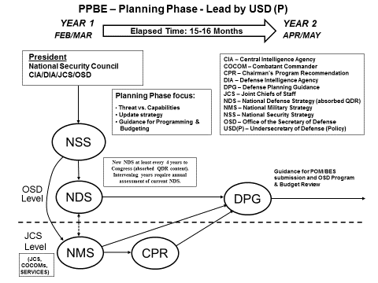
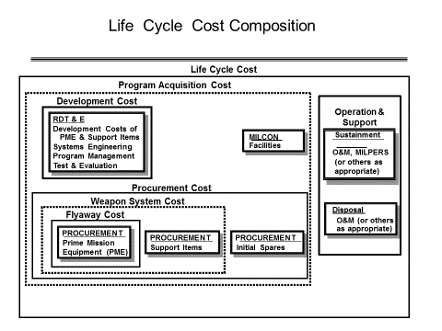
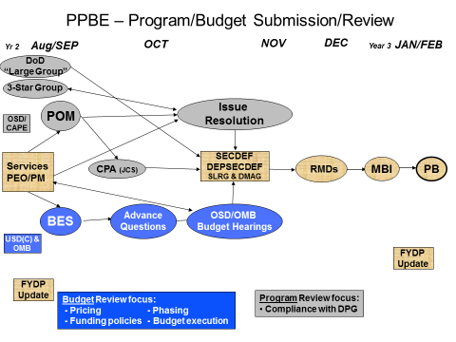
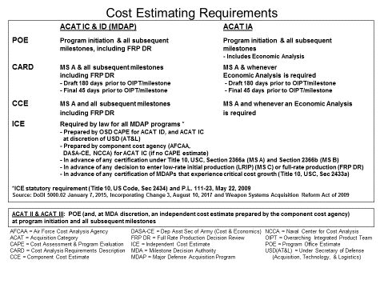
Defense Acquisition University (DAU)
Funds Management Platinum Card
Sept 2017
Platinum Card POC: james.krott@dau.mil
https://www.dau.mil/tools/t/Funds-Management-Platinum-Card
Page 1

Slide 2
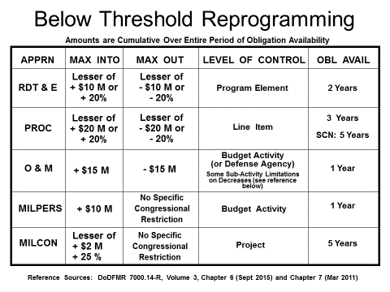
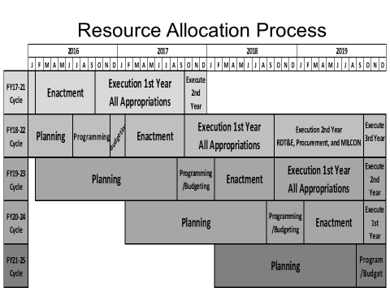
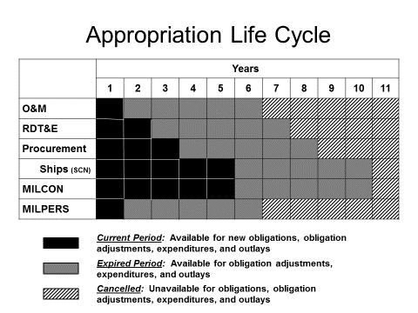
Defense Acquisition University (DAU)
Funds Management Platinum Card
Sept 2017
Page 2

